Slide 1
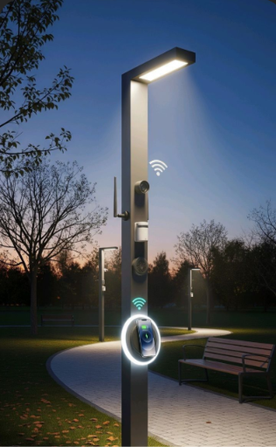
DESIGN AND SIMULATION OF AN AUTOMATIC STREET LIGHT CONTROL SYSTEM USING COMBINATION LOGIC.

Slide 2

INTRODUCTION
Automatic street lights reduce the need for manual control.
A light sensor detects whether it is day or night.
A motion sensor detects people or vehicles.
Combination logic controls the street light based on these conditions.
The system helps save electricity and improves efficiency.

Slide 3
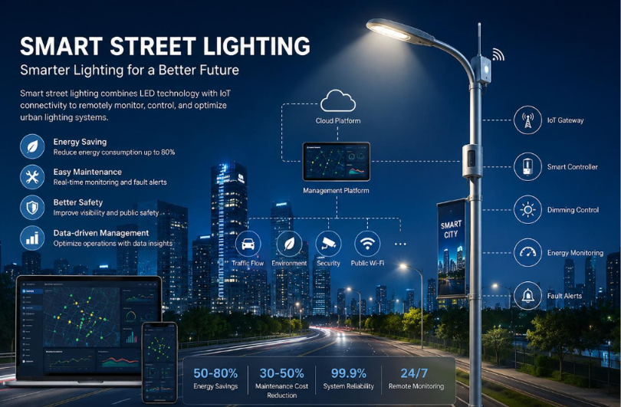
OBJECTIVES
Automate street light operation.
Reduce unnecessary power consumption.
Detect darkness using a light sensor.
Detect movement using a motion sensor.
Control the light using combination logic.

Slide 4


PROBLEMS
Manual switching requires human effort.
Street lights may remain ON during daylight.
Unnecessary lighting causes power wastage.
Lights may stay ON when no one is nearby.
Continuous operation increases electricity consumption.

Slide 5
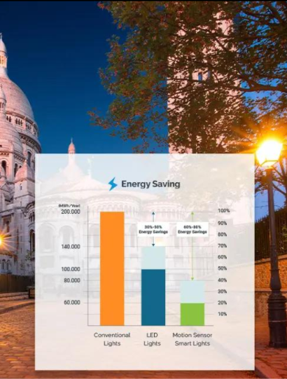
PROPOSED SOLUTION
Use an LDR sensor to detect darkness.
Use a PIR sensor to detect movement.
Combine both sensor signals using an AND gate.
Turn the street light ON only when both conditions are satisfied.
This helps reduce unnecessary power consumption.

Slide 6
COMPONENTS
LDR Sensor – Detects light intensity.
PIR Sensor – Detects movement.
AND Gate – Combines the sensor signals.
LED/Street Light – Turns ON or OFF.
Power Supply – Provides electrical power.
WORKING PRINCIPALE
Darkness detected
↓
Motion detected
↓
AND Gate
↓
Street Light ON 💡

Slide 7
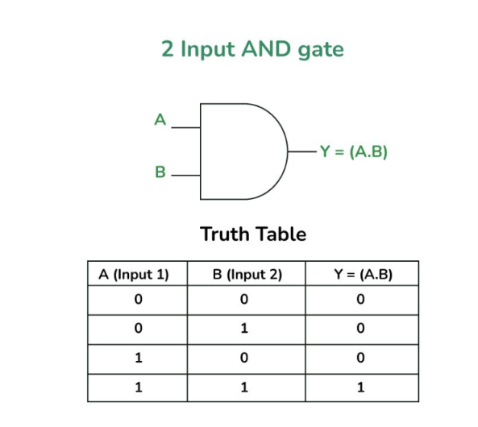
LOGIC GATE AND TRUTH TABLE
AND Gate
Combines the light sensor and motion sensor inputs.
Output is 1 only when both inputs are 1.
Boolean Expression
F = A · B

Slide 8

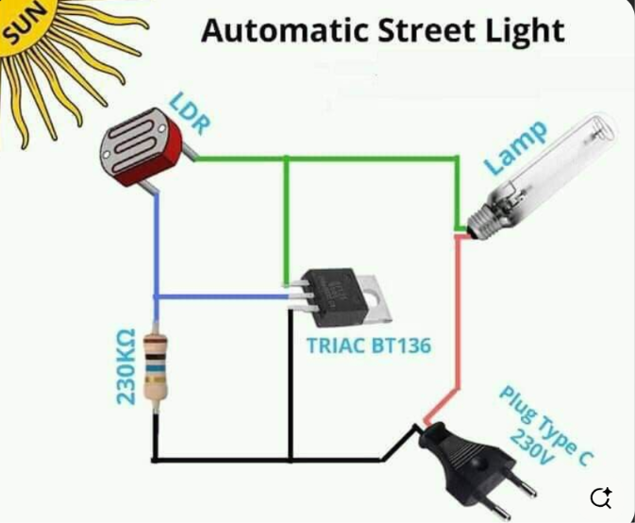
.
RESULT
Automatic control reduces unnecessary power consumption.
Combination logic provides reliable operation.
The system is simple and efficient.
CONCLUSION
Automatic street light control is achieved.
The system reduces unnecessary power consumption.
Combination logic provides efficient control.

Slide 9
THANK YOU
PRESENTED BY
YAGNAPRIYA
SRIKARI
AKSHITH
VISHWAM

